Slide 1
Incident Management
Josiah Vincent - Midpoint Presentation

Slide 2
Roadmap
Why did I choose Incident Management?
What is an “incident”?
How am I storing my data?
How am I visualizing/presenting my data?

Slide 3
Why did I choose Incident Management?
Work related
Somewhat familiar with data
Common real world reporting

Slide 4
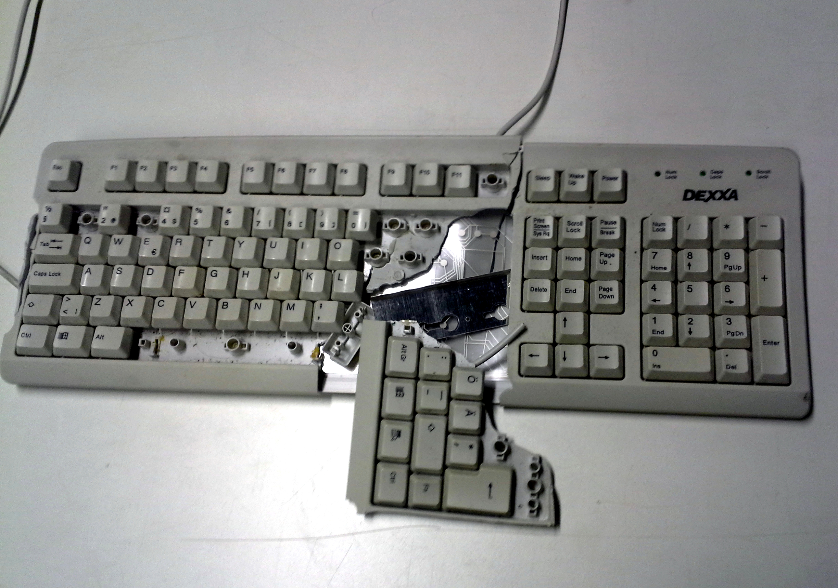
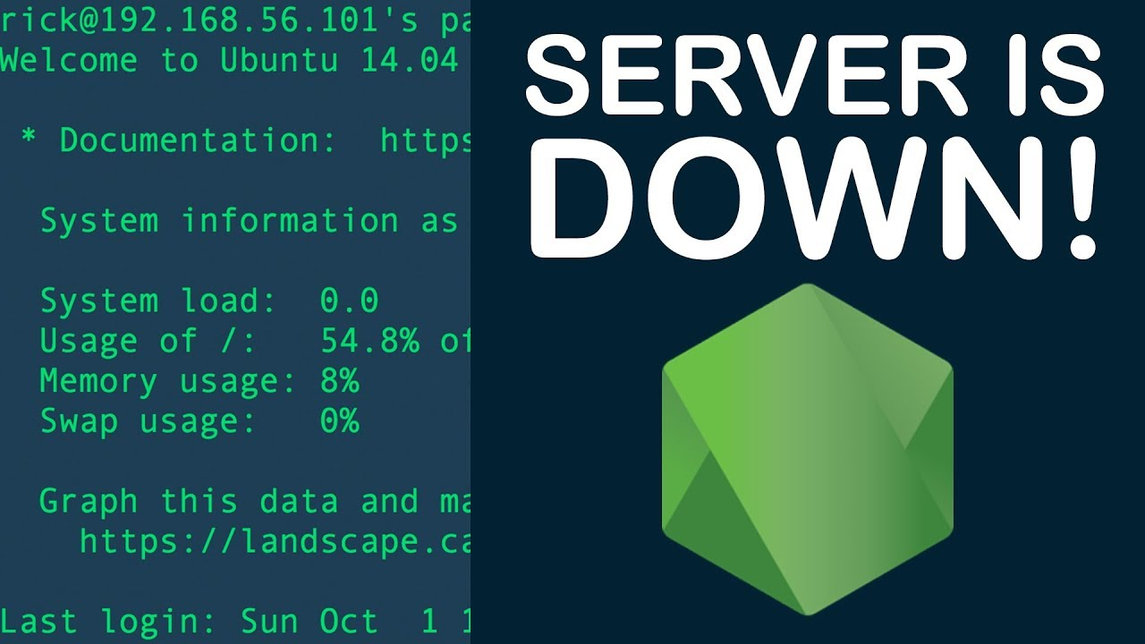
What is an “incident”?
Incident: An issue related to Information Technology that is affecting a user(s).

Slide 5
What is an “incident”? (contd.)
Incidents are tracked in a ticketing tool and given as much detail as possible.
A description of the incident
Who it is affecting
Who is resolving the issue
The primary person
The team they are a part of
Timestamps
Created, Resolved, Service Level Agreement Times, etc.

Slide 6
How am I storing my data?
The data I am using has been extracted from the ticketing tool into a subset .csv file and I am using a mysql database.
The data by nature was already in a relational structure, so it made sense to stick with that.
I imported all the data from the .csv into the DB and set all the necessary data types as well as created the keys necessary if i decide to add more tables.

Slide 7
How am I visualizing/presenting my data?
I will using PowerBI to connect to the database, transform the data, and visualize the data.
Because I am using a MySQL database it requires an additional module to be installed.
I will be using PowerBI to create a dashboard and seperate the high priority issues and breaking out each KPI into its own visual (chart, card, graph, heatmap etc.)

Slide 8
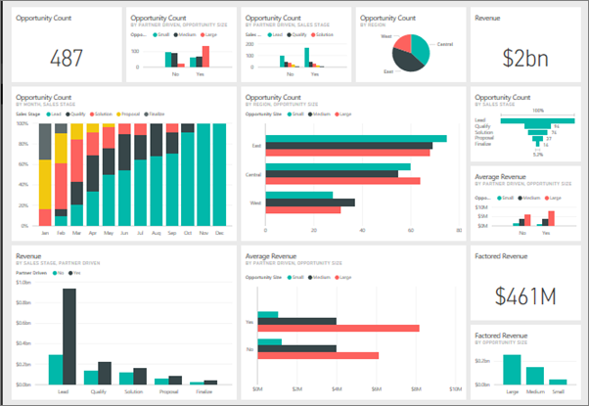
How am I visualizing/presenting my data?
(contd.)

Slide 9
Conclusion
Created a MySQL database to house all of my incident data and I am using PowerBI to transform and create the visualization dashboard for high priority incidents.

Slide 10
Questions?

